Slide 1
SWE 4101
Lec – 2
Requirements Engineering
All contents are based on textbooks, research articles, online resources, and personal experience.

Slide 2
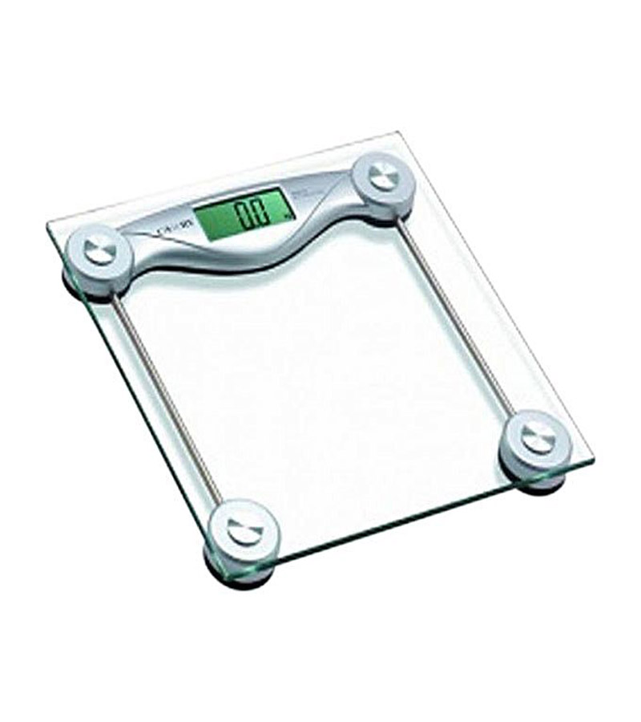
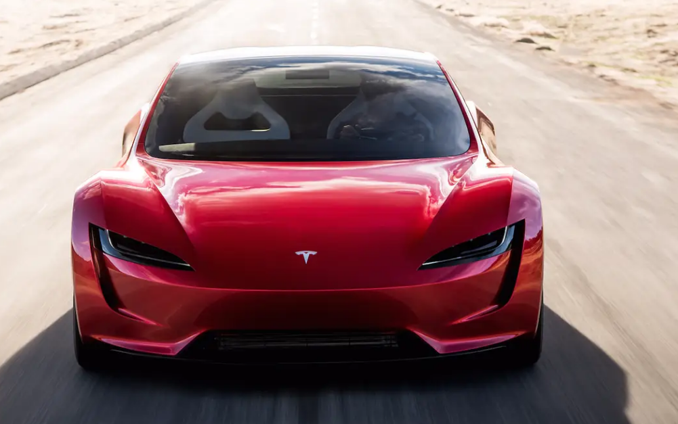
Misleading Requirements
Father: What do you want from me on your birthday?
Son: Something that moves from 0 to 60 within 3 seconds.
Father Delivered to Son
Expectation of Son

Slide 3



Misleading Requirements
Customer Requirements:
Have one trunk
Have four legs
Should carry load both passenger & cargo
Blackish in color
Should be herbivorous
Our Solution:
Have one trunk
Have four legs
Should carry load both passenger & cargo
Black in color
Should be herbivorous
Our Value addition: Also gives milk

Slide 4
Background..
What is a Requirement?
  A condition or capability that must be possessed by a system (IEEE)
The requirements task:
  Input: User needs in minds of people
  Output: precise statement of what the future system will do
What is the output of the Req. phase ?
  A software requirements specification (SRS) document
What is an SRS ?
  A complete specification of what the proposed system should do!

Slide 5
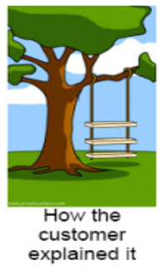
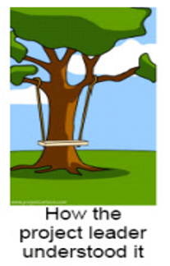
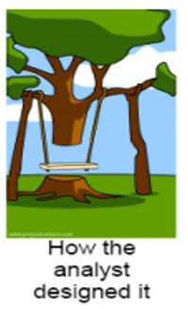
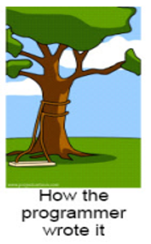
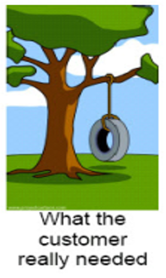
Background..
more common problems with requirements definition are :
  1. Requirements do not represent the actual needs of the customer.
  2. Requirements are incomplete or conflicting.
  3. Requirements are difficult and expensive to update after they have been agreed upon.
  4. Customers, requirements analysts, and software engineers who develop the system have difficulties understanding each other.

Slide 6
Requirement Engineering
The process of establishing the services that the customer requires from a system and the constraints under which it operates and is developed
Types of Requirements
User requirements
Statements in natural language plus diagrams of the services the system provides and its operational constraints.
Written for customers.
System requirements
A structured document setting out detailed descriptions of the system’s functions, services and operational constraints

Slide 7

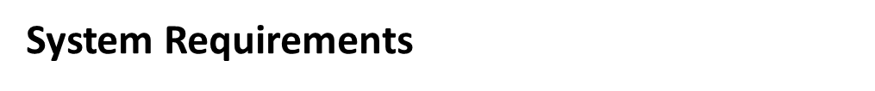
On the last working day of each month, a summary of the drugs prescribed, their cost, and the prescribing clinics shall be generated.
The system shall automatically generate the report for printing after 17.30 on the last working day of the month.
If drugs are available in different dose units (e.g., 10 mg, 20 mg) separate reports shall be created for each dose unit.

Slide 8
Functional and Non-functional requirements
Functional requirements
Describe functionality or system services.
Depend on the type of software, expected users and the type of system where the software is used.
Functional user requirements may be high-level statements of what the system should do.
Functional system requirements should describe the system services in detail.

Slide 9
Functional and Non-functional requirements
Non-functional requirements
These define system properties and constraints e.g. reliability, response time, maintainability, scalability, portability, and storage requirements.
Constraints are I/O device capability, system representations, etc.
Process requirements may also be specified mandating a particular IDE, programming language or development method.
Non-functional requirements may be more critical than functional requirements. If these are not met, the system may be useless
Non-functional requirements may affect the overall architecture of a system rather than the individual components.

Slide 10
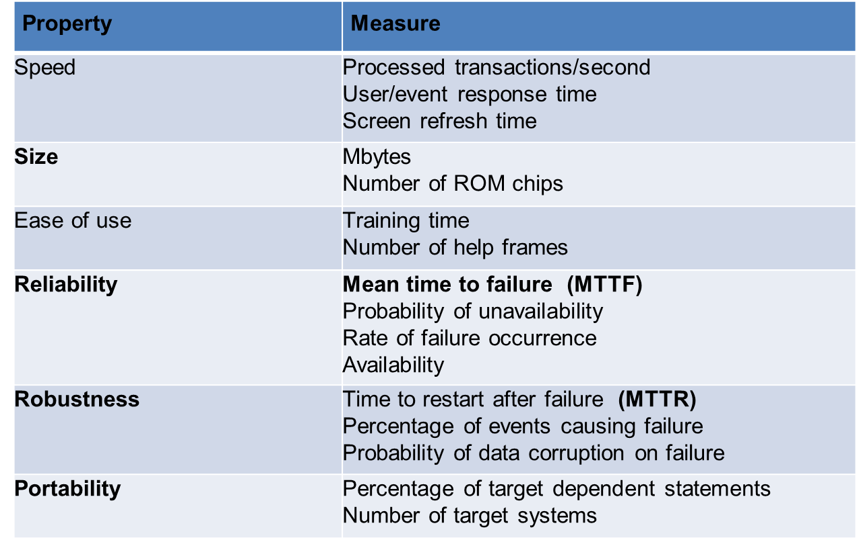
Functional and Non-functional requirements
Non-functional requirements
Metrics for specifying nonfunctional requirements

Slide 11
Problem domain
Software (Solution) domain
Describes
problem
Requirements
Specifi
cation
Program
Customer
Specifies
Analyzes
Develops
We receive “customer problem statement,” not the requirements!
Software Engineer

Slide 12
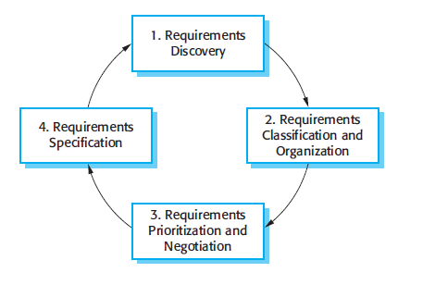
requirements engineering process
Requirements elicitation and analysis process
Requirements discovery is the process of interacting with stakeholders of the system to discover their requirements.
Requirements classification and organization takes the unstructured collection of requirements, groups related requirements, and organizes them into coherent clusters.
Requirements prioritization and negotiation takes place when multiple stakeholders are involved, requirements will conflict. This activity is concerned with prioritizing requirements and finding and resolving requirements conflicts through negotiation.
Requirements specification is the process of documenting all the requirements and input into the next round.

Slide 13
requirements engineering process
Requirements Validation
is the process of interacting with stakeholders of the system to discover their requirements.
During the requirements validation process, different types of checks should be carried out on the requirements in the requirements document.
    Validity checks
    Consistency checks
    Completeness checks
    Realism checks
    Verifiability
If a requirement states that the system should load a page "quickly," the verifiability check would ensure that this requirement is stated in measurable terms, such as “the page should load within 2 seconds under typical network conditions.
If the requirement is to implement real-time data analysis for millions of users within a short time frame, the realism check would assess if current infrastructure can support such demands.
If a system is being designed to process online payments, completeness checks would ensure that requirements for payment validation, transaction failure handling, and refund processing are also documented.
If one requirement specifies that the system should allow only authenticated users to access certain data, but another requirement suggests the data should be publicly accessible, this inconsistency needs to be addressed.
If a user requests a feature to send notifications to mobile devices, the validity check would confirm that the feature supports all relevant mobile platforms the users expect, like Android and iOS.

Slide 14
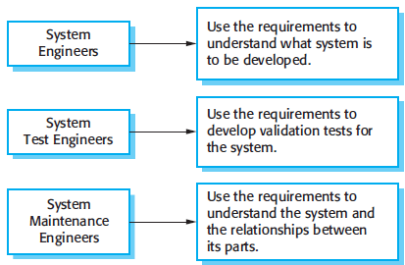
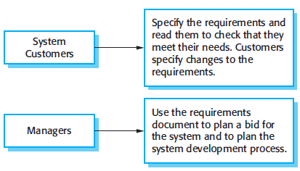
software requirements document
Called the software requirements specification or SRS
an official statement of what the system developers should implement.
include both the user requirements for a system and a detailed specification of the system requirements.
The requirements document has a diverse set of users

Slide 15
Components of an SRS
An SRS must specify following types of requirements:
  Functional
  Performance (sometime mentioned as non-functional requirement)
  Design constraints
  External interfaces

Slide 16
Components of an SRS
Types of Requirements
Functional
Non-functional
Specifies all the functionality that the system should support
Outputs for the given inputs and the relationship between them
All operations the system is to do
Must specify behavior for invalid inputs too
All the performance constraints on the software system
Generally on response time , throughput etc
Capacity requirements
Must be in measurable terms
Design Constraints
External Interface
Factors in the client environment that restrict the choices
Some such restrictions
  Standard compliance and compatibility with other systems
  Hardware Limitations
  Reliability, fault tolerance, backup req.
  Security
All interactions of the software with people, hardware, and sw
User interface most important
General requirements of “friendliness” should be avoided
These should also be verifiable
The system shall allow users to make payments using credit cards, debit cards, and PayPal.

Slide 17
Characteristics of SRS
Correctness
Each requirement accurately represents some desired feature in the final system
Consistent
two requirements don’t contradict each other
Completeness
All desired features or characteristics are specified
Completeness and correctness strongly related
Ranked for importance/stability
Needed for prioritizing in construction
To reduce risks due to changing requirements
SRS
Characteristics
Unambiguous
Each req has exactly one meaning
Without this errors will creep in
Important as natural languages often used
Traceable
The origin of the req, and how the req relates to software elements can be determined
Verifiability
There must exist a cost effective way of checking if sw satisfies requirements

Slide 18
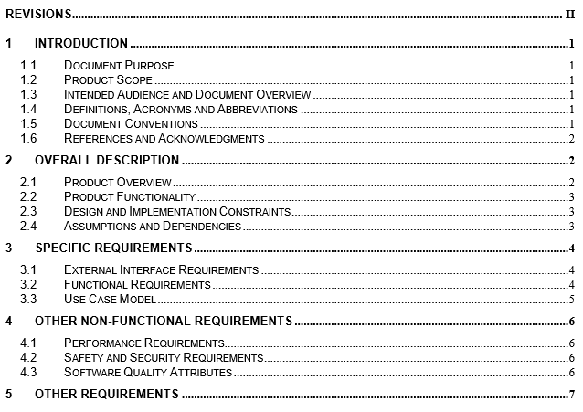
SRS Contents

Slide 19
Requirements Review
SRS reviewed by a group of people
Group: author, client, user, dev team rep.
Must include client and a user
Process – standard inspection process
Effectiveness - can catch 40-80% of req. errors

Slide 20
Requirements in Agile

Slide 21
Requirements in Agile
Agile teams use user stories to capture user requirements in a simple, non-technical format.
A user story is typically written in the form of:
  As a [type of user], I want to [perform some action] so that [some reason or benefit].
  As a [user role], I want [requirement] so that [goal].
Example:
  As a customer, I want to save my payment information so that I can complete future purchases faster.
  As an online gamer, I want to see health information all the time on the screen so that I conveniently monitor my status.
  As a passenger, I want to see the driver's phone number so that I can call or text him/her in case we don’t find one another.
  As a social media user, I want to add a picture to my profile so that other users know what I look like.
  As a credit card holder, I want to see the list of recent transactions so that I control my spending.

Slide 22





How to write user stories?
Ron Jeffries, the founder of Extreme Programming, proposed a so-called 3 C formula, describing the three essential components of user stories: Card, Conversation, and Confirmation.
Stories are traditionally written on note cards.
Cards may be annotated with estimates, notes, etc.
Details behind the story come out during conversations with product owner
Acceptance tests confirm a story was coded correctly.

Slide 23
User interface Design

Slide 24
The $300 Million Button
user filled their shopping cart with products and pressed the Checkout button
a form with two fields (email, pass), two buttons (login,register), and one link(forgot pass) comes before they could actually enter the information to pay for the product.
How could they have problems with it?
Even some 1st time shopper said “I’m Not Here To Be In a Relationship, I just want to buy something.”
Some 1st time shoppers couldn’t remember if it was their first time, becoming frustrated as each common email and password combination failed.
Database Analysis:
  45% of customers had multiple registrations.
  Some customers had up to 10 registrations.
Password Requests:
  160,000 password requests per day.
  75% of customers did not complete purchases after requesting a password.
Many vocalized how the retailer only wanted their information to send them with marketing messages they didn’t want.
Repeat customers weren’t any happier. Except for a very few who remembered their login information, most stuck on the form.
couldn’t remember the email address or password they used. Remembering which email address they registered with was problematic – many had multiple email addresses or had changed them over the years.

Slide 25
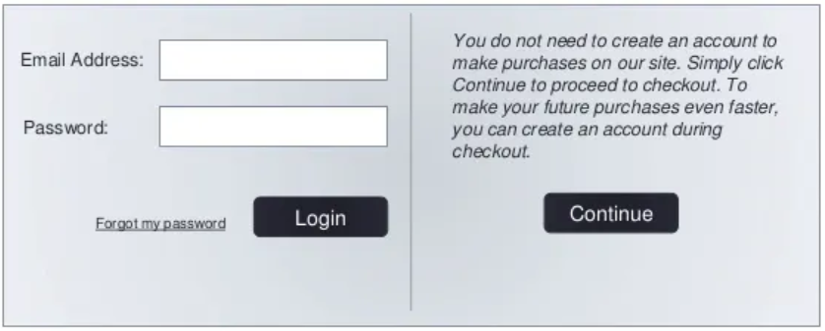
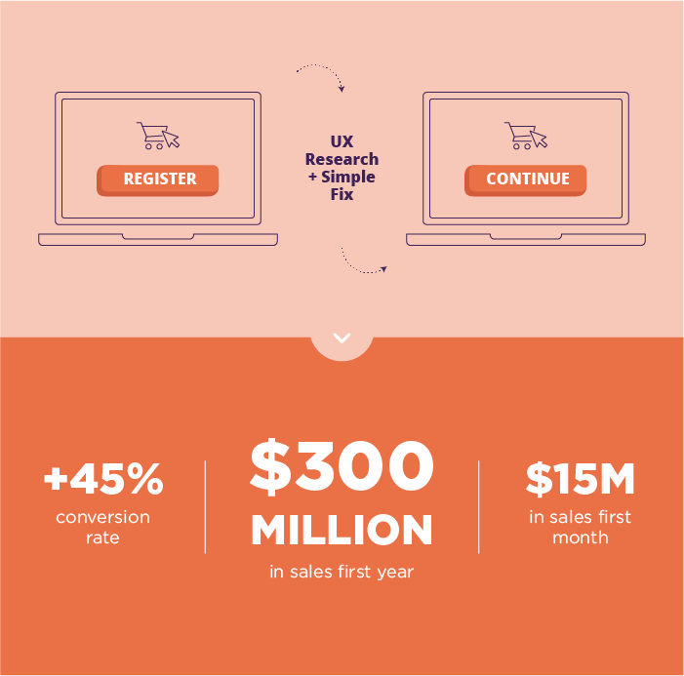
The $300,000,000 Fix
designers fixed the problem simply.
They took away the Register button
In its place, they put a Continue button with a simple message:
The results: The number of customers purchasing went up by 45%. The extra purchases resulted in an extra $15 million the first month. For the first year, the site saw an additional $300,000,000.

Slide 26
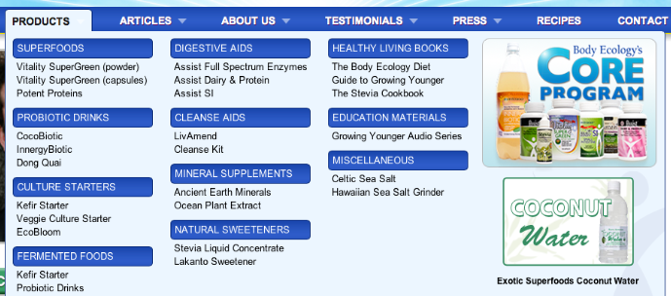
Removing Drop-down Increases Revenue 56.43%
Body Ecology is an e-commerce store that sells diet products. They employed a drop-down menu to help narrow down the customers’ choices
the drop-down menu gives only text links to products. It doesn’t display a picture of the product

Slide 27
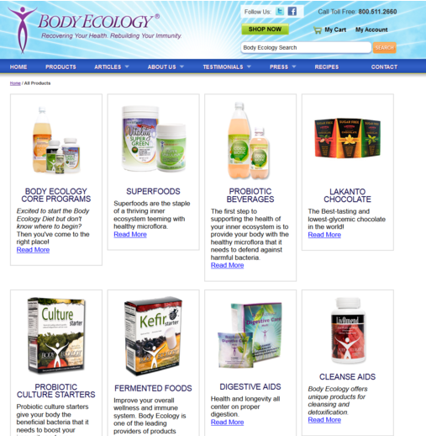
Removing Drop-down Increases Revenue 56.43%
wanted to see if removing this drop-down menu and replacing it with a products page would increase order conversion. This is the replacement:
The product page beat the drop-down menu by 56.43%, resulting in a total increase in revenue of $8,880 over a two-week period.

Slide 28
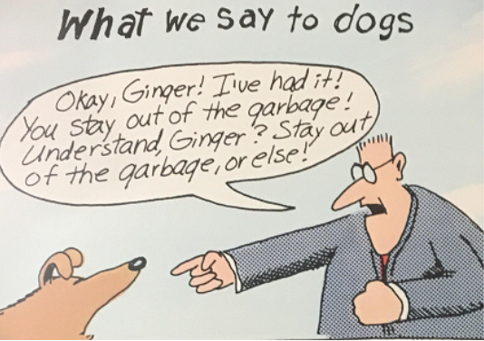
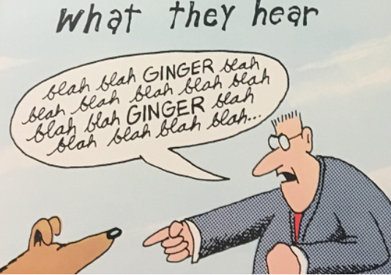
Larson’s dog effect
Same with Software
Thank you for registering! We appreciate your business.
To activate your software, you will be sent an email key. After you have received the key then you will be able to click here and you can then proceed with the activation process.
Blah blah blah blah blah blah blah blah blah blah blah blah blah blah blah blah blah blah blah blah blah blah blah click here blah blah blah blah blah blah blah blah blah blah blah

Slide 29
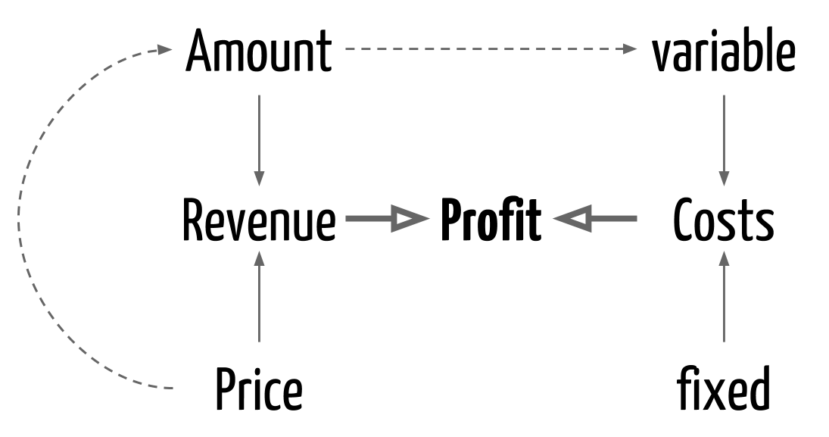
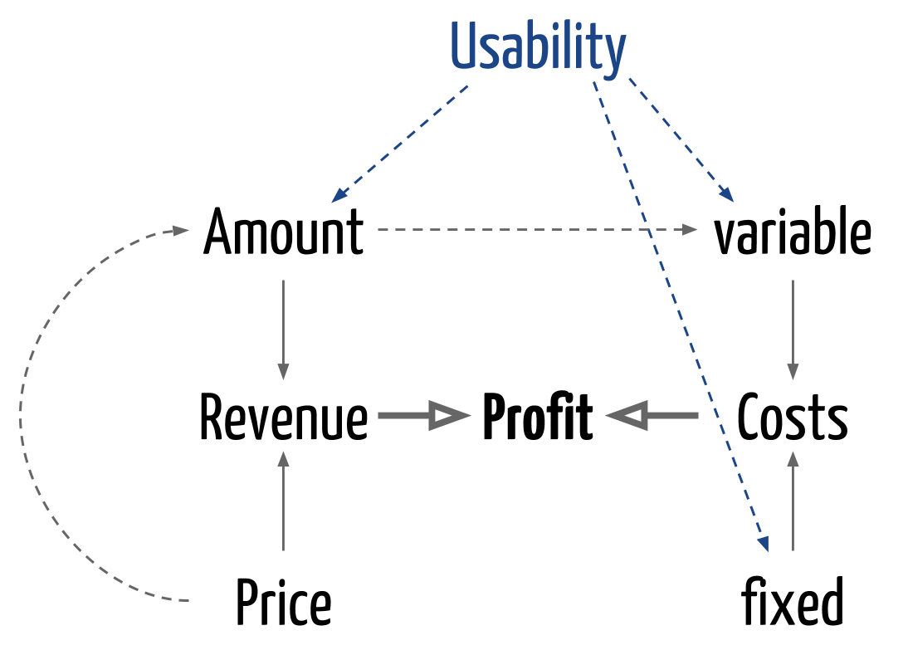
How usability impacts profit

Slide 30
Why is usability important?
Poor usability results in
  anger and frustration
  decreased productivity in the workplace
  higher error rates
  physical and emotional injury
  equipment damage
  loss of customer loyalty
  costs money

Slide 31
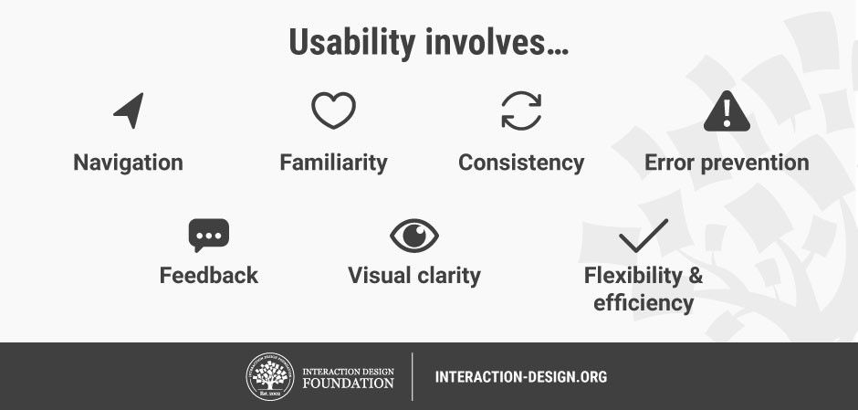
What is usability?
Usability is a measure of the effectiveness, efficiency and satisfaction with which specified users can achieve specified goals in a particular environment.

Slide 32
The user interface
The user interface is the way for the users to communicate with the computer system and/or the application system.
User interfaces should be designed to match the skills, experience and expectations of its anticipated users.
System users often judge a system by its interface rather than its functionality.
A poorly designed interface can cause a user to make catastrophic errors.
Poor user interface design is the reason why so many software systems are never used.

Slide 33
Human factors in interface design
Limited short-term memory
  People can instantaneously remember about 7 items of information. If you present more than this, they are more liable to make mistakes.
People make mistakes
  When people make mistakes and systems go wrong, inappropriate alarms and messages can increase stress and hence the likelihood of more mistakes.
People are different
  People have a wide range of physical capabilities. Designers should not just design for their own capabilities.
People have different interaction preferences
  Some like pictures, some like text.

Slide 34
UI Design: Things to consider
Assume users
  Have not read the manual
  Have not attended training
  Do not have external help readily at hand
So…
All controls should be clear and understandable and placed in an intuitive location on the screen.

Slide 35
UI Design: Things to consider
UI design must take account of the needs, experience and capabilities of the system users.
Designers should be aware of people’s physical and mental limitations (e.g. limited short-term memory) and should recognise that people make mistakes.
UI design principles are the basis for creating good interfaces, but not all principles apply to every design.

Slide 36


User interface Design principles
User familiarity
  The interface should be based on user-oriented terms and concepts rather than computer concepts. For example, an office system should use concepts such as letters, documents, folders etc. rather than directories, file identifiers, etc.
Consistency
  The system should display an appropriate level of consistency. Commands and menus should have the same format, command punctuation should be similar, etc.
Minimal surprise
  If a command operates in a known way, the user should be able to predict the operation of comparable commands

Slide 37
User interface Design principles
Recoverability
  The system should provide some resilience to user errors and allow the user to recover from errors. This might include an undo facility, confirmation of destructive actions, 'soft' deletes, etc.
User guidance
  Some user guidance such as help systems, on-line manuals, etc. should be supplied
User diversity
  Interaction facilities for different types of user should be supported. For example, some users have seeing difficulties and so larger text should be available

Slide 38
Design issues in UIs
Two problems must be addressed in interactive systems design
  How should information from the user be provided to the computer system?
  How should information from the computer system be presented to the user?

Slide 39
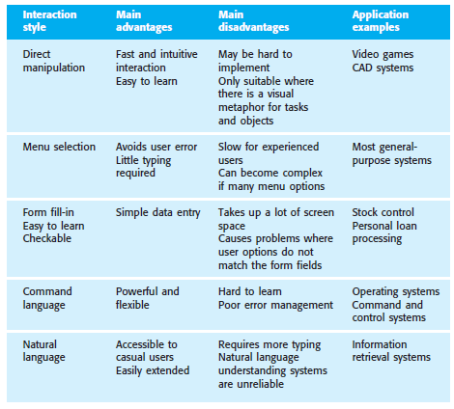
Interaction styles

Slide 40
User Centered Design (UCD)
UCD is a dialog between the customer and the designer
Key Principles of User-Centered Design:
  User Involvement: Actively involve users at every stage of the design process to ensure the product meets their real needs.
  Iterative Process: Design is done in cycles, with user feedback guiding improvements in each iteration.
  Usability Focus: Emphasize ease of use, learning, and satisfaction in the final design.
  Context of Use: Understand how and where users will interact with the product to ensure it fits into their real-life environment.

Slide 41

User Centered Design Process
Review
Review the interaction design with customers
Plan
Define user Requirements & analyze competitors
Prototype
Develop and test prototype for usability
Design
Design interaction and navigations

Slide 42
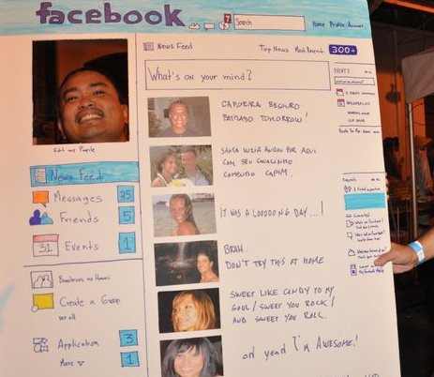
Example : Paper prototype
Notes:
4242

Slide 43
UI Design is Multi Disciplinary
A team includes
  Analyst
  Designer
  Technology expert
  Graphic artist
  Social and behavioral scientist
  Programmer

Slide 44
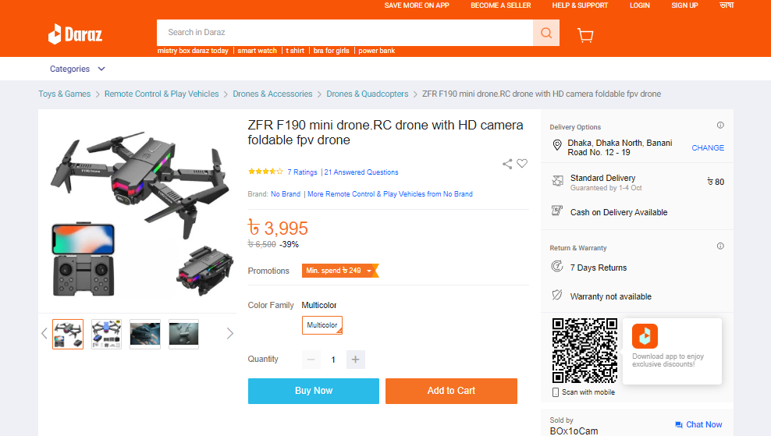
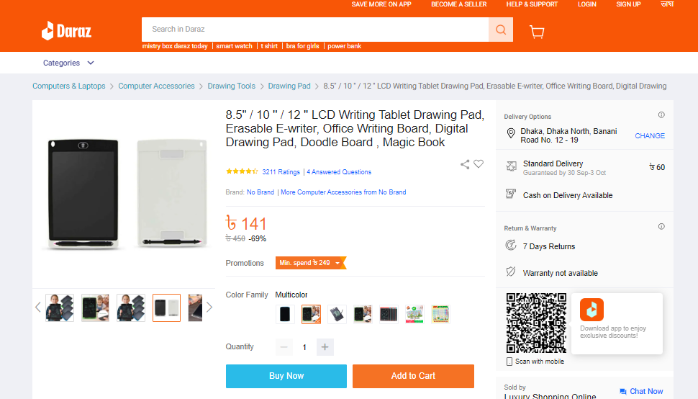
Golden Rules for Better Interface Design
1. Strive for Consistency
Designing “consistent interfaces” means using the same design patterns and the same sequences of actions for similar situations.
a consistent interface will allow your users to complete their tasks and goals much more easily.

Slide 45
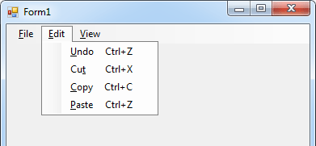
Golden Rules for Better Interface Design
2. Enable Frequent Users to Use Shortcuts
Users will benefit from shortcuts if they need to complete the same tasks often.
Expert users might find the following features helpful:
  Abbreviations
  Function keys
  Hidden commands
  Macro facilities

Slide 46
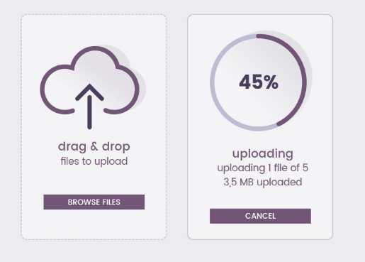
Golden Rules for Better Interface Design
3. Offer Informative Feedback
need to keep users informed of what is happening at every stage of their process.
This feedback needs to be meaningful, relevant, clear, and fit the context.

Slide 47
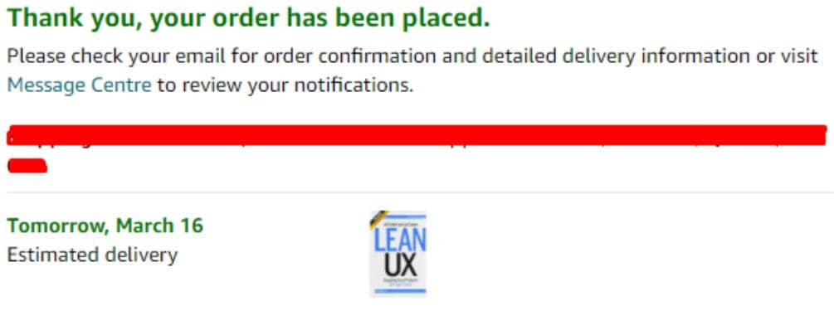
Golden Rules for Better Interface Design
4. Design Dialog to Yield Closure
Sequences of actions need to have a beginning, middle and end.
Your user must see the path in his action
by offering him the end of an interaction through feedback you reduce his mental load and improve his experience on your interface.
Don’t keep them wondering!

Slide 48
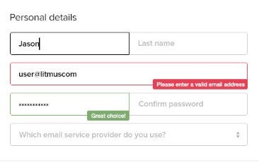
Golden Rules for Better Interface Design
5. Offer Simple Error Handling
Design the interface to minimize the chance of user mistakes by using intuitive controls and validation checks.
Provide concise, easy-to-understand notifications that explain what went wrong.
Offer helpful hints or steps to guide users in solving the issue quickly.

Slide 49
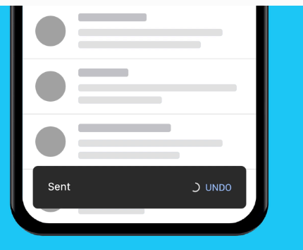
Golden Rules for Better Interface Design
6. Permit Easy Reversal of Actions
It’s an instant relief to find that “undo” option after a mistake is made.
Users will feel less anxious and more likely to explore options if they know there’s an easy way to reverse any accidents.
This rule can be applied to any action, group of actions, or data entry.

Slide 50
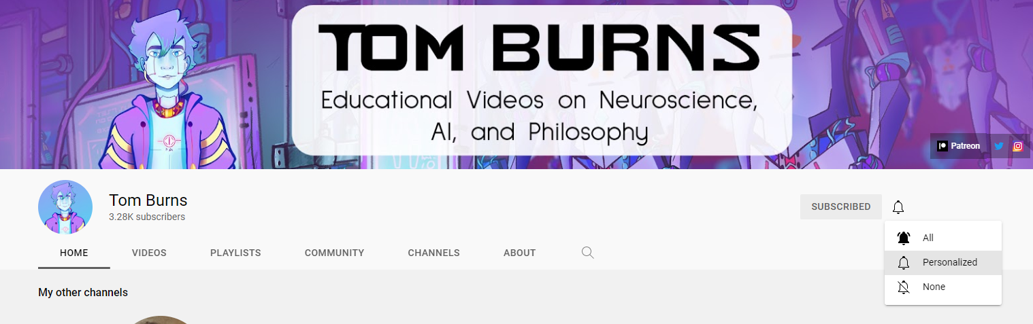
Golden Rules for Better Interface Design
7. Support Internal Locus of Control
It’s important to give control and freedom to your users so they’re able to feel they’re in charge of the system, not the other way round.
Users should be the initiators of the actions rather than the responders.

Slide 51
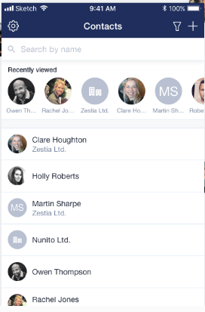
Golden Rules for Better Interface Design
8. Reduce Short-Term Memory Load
Design clean and straightforward interfaces that avoid unnecessary complexity.
Include features like a list of recently viewed or purchased items to help users easily access relevant information.
don’t make your user remember more things than necessary.

Slide 52
Assignment
You are using many mobile applications. Surely you are not happy with all User interfaces of the apps you are using. Choose one of such app with poor user interface. And Redesign the User Interface for better usability. Write 5 sentence why your designed UI is more usable that the existing one.

Slide 53
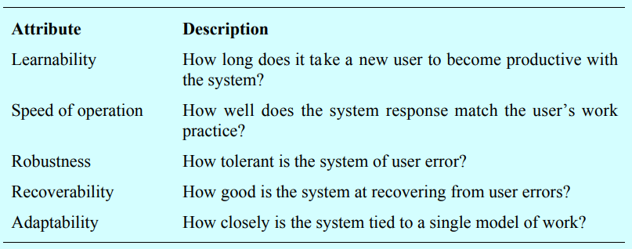
User interface evaluation
Some evaluation of a user interface design should be carried out to assess its suitability.
Full scale evaluation is very expensive and impractical for most systems.
Ideally, an interface should be evaluated against a usability specification. However, it is rare for such specifications to be produced.

Slide 54
evaluation techniques
Less expensive techniques for user interface evaluation:
  Questionnaires
  Observations of users at work
  Video snapshots of typical uses
  Software components that gather information on the usage of the user interface
  Software components that allow direct feedback from users

Slide 55
“Walk a mile in the user’s shoes”

